Slide 1
Rates
Year 11 Essentials

Slide 2
t: Conversion of Rates
EQ: How do we convert units in rates?
A rate is a unit of measurement compared to a time unite.
Examples of rates are $/hr for a tradesperson, mL/hr for an IV drip, Km/hr for driving ect
Rates can be converted between units, by first converting the measurement unit, then the time unit.
Task 1: convert 30km/h to m/s
Hints: convert km to m how many seconds are in an hour

Slide 3
Answer
30km/h
= 30000m/h
= 8.3m/s
There is 1000m in a km, so multiply by 1000
There is 3600seconds in an hour, so divide by 3600
The short cut is to divide by 3.6

Slide 4
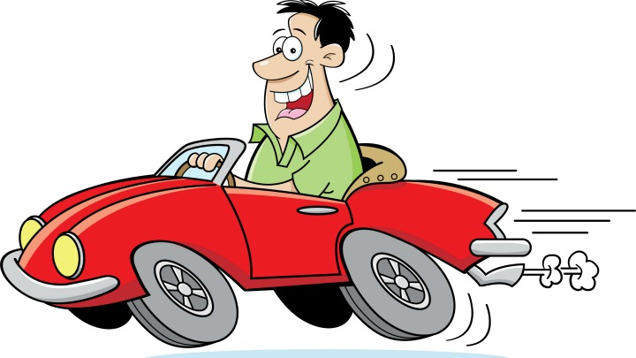
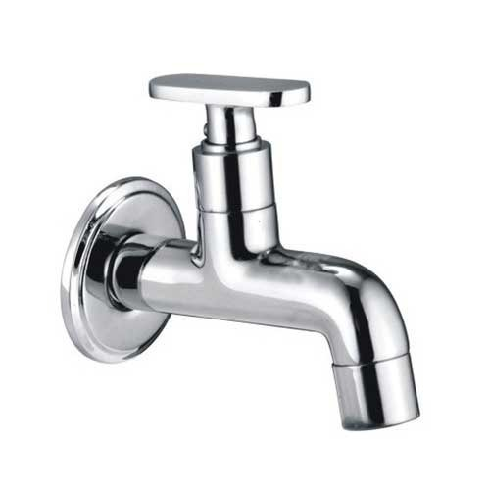
24
7
30
Date: October 2021
Rates
EQ – EQ: How do we convert units in rates?
Speed
Km/h to m/s divide by 3.6
m/s to km/h multiply by 3.6
Mr Power
mL/min to L/h multiply by 0.06
L/h to mL/min divide by 0.06
Flow rate

Slide 5
Convert the following
100km/h to m/s
4m/s to km/h
400ml/min to L/h
600km/h to m/s
7L/h to mL/min
Challenge
50km/h to m/min
90mL/min to mL/sec
Remember: convert the Measurement unit to the Measurement rate unit, then convert for time.
Answers:
1. 27.78 m/s
2. 14.4 km/s
3. 24L / hr
4. 166.67 m/s
5. 116.67 mL/min
6. 50/3.6 = 13.89 m/s *60 = 833.33 m/min
7. 90 * 0.06 = 5.4 / 60 = 0.09 ml/sec

Slide 6
Mr Power travels at an average speed of 95km/h, how far does he travel in:
Two hours?
30 mins?
5 hours?
1 hour and 20 minutes
20 seconds?
95 / 1hrs -> x2 hour = 190 km / 2 hours
95 / 1hr -> x0.5 hour = 47.5 km / 0.5 hours
95 / 1hr x 5 ->475 km / 5 hours
95 / 1hr -> 95 / 60 minutes -> 1.583 / 1 minute -> x80 = 126.67 km / 80 minutes (1hr and 20 = 80 minutes)
95 / 1hr -> 95 / 60 second -> 95 km in 3600 seconds -> 0.026 km/ 1 second x 20 = 0.5278km / 20 seconds
Mr Power

Slide 7
Complete Exercise 92 from the interleaved text book:
Page 126/127 – Comparing options using Speed.
Remember: Speed = Distance divided by time.
Eg 200km in 4 hours
= 200 / 4
=50 km an hour is the speed.

